Slide 1


DROWSINESS DETECTOR
PRESENTED BY
Ebishdon G V
Aiswarya S M

Slide 2

1
4
DATASET AND CODE EXECUTION
INTRODUCTION
Agenda
2
5
CHALLENGES AND LIMITATIONS
OBJECTIVE
3
PROPOSED SOLUTION
6
CONCLUSION

Slide 3

I N T R O D U C T I O N
In 2019, drowsy driving accounted for approximately 697 fatalities and a staggering 33,000 injuries in the United States alone, underscoring the urgent need for effective solutions to combat this pressing road safety issue (NHTSA, 2019). Drowsy driving incidents are most prevalent during late-night and early-morning hours, posing a significant risk to drivers and passengers alike. Younger drivers under the age of 25 and commercial truck drivers are particularly vulnerable to drowsiness-related accidents.

Slide 4


Add Company Name
Safety Enhancement
Emphasize the paramount importance of drowsiness detection in improving safety, preventing accidents, and saving lives in various domains, including transportation and critical work environments.
Objectives
G O A L O F O U R P R O J E C T
Practical Implementation
Provide insights into how drowsiness detection technology can be practically implemented in different contexts, enabling the audience to grasp its feasibility and potential for real-world use.

Slide 5

P R O P O S E D
S O L U T I O N
We propose a comprehensive solution for drowsiness detection leveraging the power of Machine Learning (ML) and Deep Learning (DL).
This high-level approach represents a significant advancement in drowsiness detection technology.
ML/DL techniques enable the creation of sophisticated models like LSTM which can enhances drowsiness detection by modeling and capturing temporal patterns in data, particularly valuable in real-time applications for recognizing subtle indicators of drowsiness. that can learn and adapt from data, making them highly effective for complex tasks like drowsiness detection.
These models have the ability to process large amounts of data, identify subtle patterns, and make real-time decisions with high accuracy.

Slide 6
H O W W E O V E R C O M E
E X I S T I N G
L I M I T A T I O N S ?
Existing drowsiness detection methods often rely on rule-based or threshold-based approaches, which can be limited in their adaptability and accuracy.
ML/DL-based systems, on the other hand, can learn from diverse datasets, adapting to individual variations and changing conditions.
They excel at capturing nuanced patterns and can differentiate between different states of drowsiness, significantly reducing false alarms and missed detections.

Slide 7
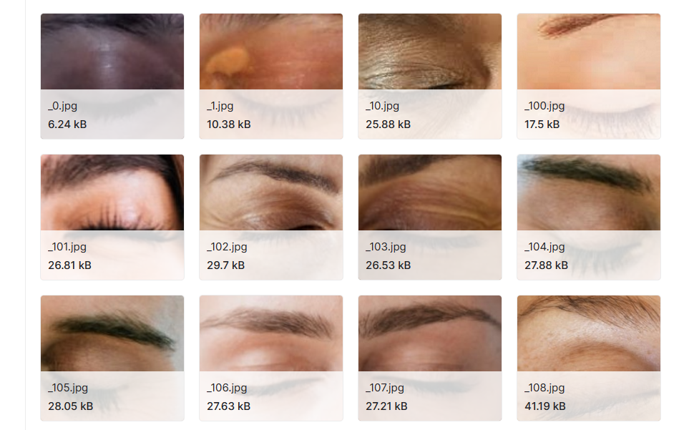
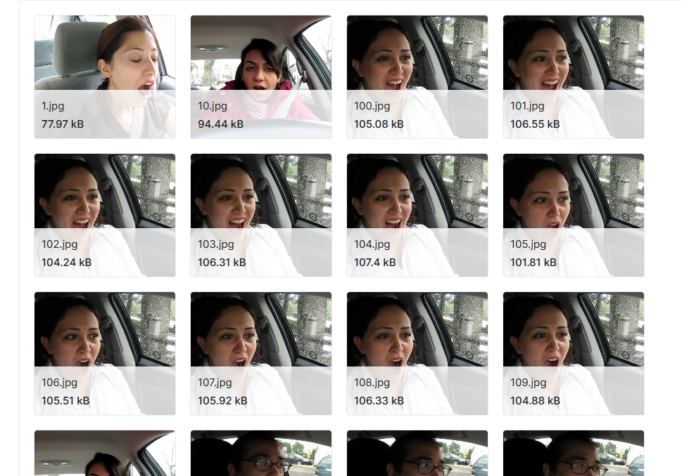
DATASET
https://www.kaggle.com/datasets/dheerajperumandla/drowsiness-dataset

Slide 8

CODE EXECUTION

Slide 9
P O T E N T I A L
I M P A C T
The adoption of ML/DL for drowsiness detection has the potential to revolutionize safety across various domains:
In transportation, it can prevent accidents caused by drowsy driving, saving lives and reducing injuries.
In the workplace, it can enhance the safety of employees operating heavy machinery or performing critical tasks.
In healthcare, it can ensure the alertness of healthcare professionals, preventing errors and ensuring patient safety.
Beyond safety, this technology can improve overall well-being by reducing fatigue-related stress, enhancing productivity, and promoting healthier lifestyles.

Slide 10
1 | Data Quality and Diversity: Obtaining a comprehensive dataset that covers a wide range of individuals, conditions, and drowsiness levels is challenging but essential for training robust models.
2 | Real-time Processing: Achieving real-time drowsiness detection in applications like driver monitoring or critical work environments demands high computational efficiency and low latency, which can be technically demanding.
3 | Generalization Across Individuals: Ensuring that the detection model generalizes effectively to diverse individuals with varying facial features, eye behavior, and expressions can be complex.
4 | False Positives and Negatives: Drowsiness detection systems can produce false alarms (false positives) or miss genuine instances of drowsiness (false negatives), affecting their reliability and user trust.
5 | Environmental Factors: Variations in lighting, noise levels, and other environmental conditions can impact the accuracy of drowsiness detection, particularly in uncontrolled settings.
6 | Privacy and Ethical Concerns: Monitoring individuals for drowsiness signs raises privacy and ethical concerns, requiring careful consideration of consent, data privacy, and potential biases in decision-making.
C H A L L E N G E S
A N D
L I M I T A T I O N S

Slide 11
Drowsiness detection using machine learning and deep learning technologies is of paramount importance, holding the potential to save lives and prevent accidents in various critical settings. While it offers significant promise, it also presents challenges, including data diversity, real-time processing, and ethical considerations, that must be addressed for responsible and effective implementation. Recognizing the vital role of drowsiness detection in enhancing safety and well-being, it is imperative that we continue to advance this technology while remaining vigilant about its limitations, striving for a future where it contributes to a safer and more secure society.
C O N C L U S I O N

